Slide 1
Wan Changli/wwx408647
2020.2.17

Slide 2
SDN and NFV Overview

Slide 3
The open ecosystem of the computing industry brings booming development of multiple fields, such as Commercial Off-the-Shelf (COTS), operating system, virtualization, middleware, cloud computing, and software applications. The network industry is also seeking transformation and development. Software Defined Networking (SDN) and Network Functions Virtualization (NFV) are mainly used.
This course aims to help engineers understand the development of SDN and NFV and introduce Huawei SDN and NFV solutions.

Slide 4
Upon completion of this course, you will be able to:
Describe the development of SDN and NFV.
Understand basic principles of OpenFlow.
Understand Huawei SDN solution.
Understand the standard NFV architecture.
Understand Huawei NFV solution.

Slide 5
SDN Overview
NFV Overview

Slide 6
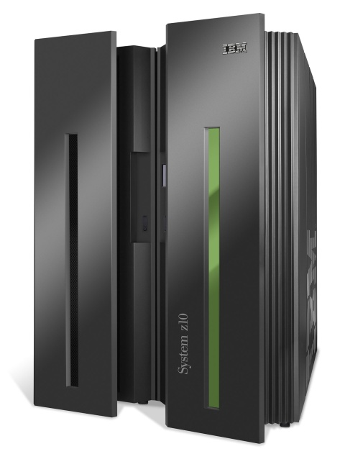
Evolution of the Computer Era
Mainframe
PC (compatible)
App
Dedicated application
Open interface
Windows
(OS)
Linux
Mac
OS
or
or
Dedicated OS
Dedicated hardware
Open interface
Microprocessorr
Vertical integration and closed interfaces
Small-scale industry applications
Horizontal integration and open interfaces
Large-scale application across industries
Notes:
In 1964, IBM spent US$5 billion on developing IBM System/360 (S/360), which started the history of mainframes. Mainframes typically use the centralized architecture. The architecture features excellent I/O processing capability and is the most suitable for processing large-scale transaction data. Compared with PCs, mainframes have dedicated hardware, operating systems, and applications.
PCs have undergone multiple innovations from hardware, operating systems, to applications. Every innovation has brought about great changes and development. The following three factors support rapid innovation of the entire PC ecosystem:
Hardware substrate: The PC industry has adapted a simple and universal hardware base, x86 instruction set.
Software-defined: The upper-layer applications and lower-layer basic software (OS and virtualization) are greatly innovated.
Open-source: The flourishing development of Linux has verified the correctness of open source and bazaar model. Thousands of developers can quickly formulate standards to accelerate innovation.

Slide 7



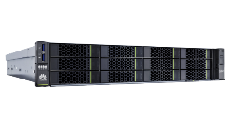
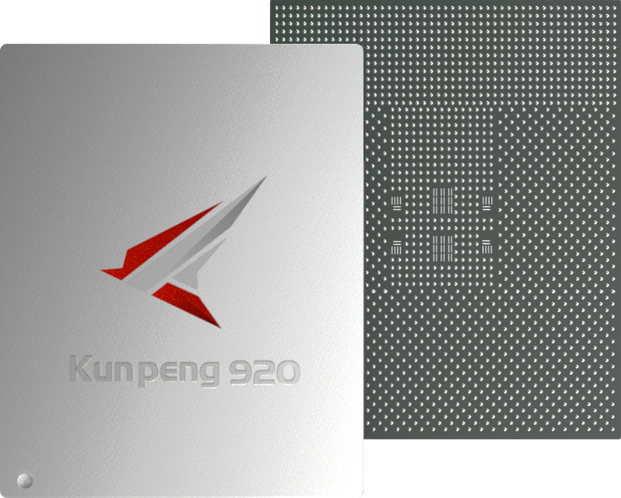
Network Industry Development: Implications from the IT Industry
The transformation of the IT industry has triggered the thinking of the network industry. The industry has proposed the SDN concept and has made attempts to put SDN into commercial use, aiming to make networks more open, flexible, and simple.
Computing Industry Openness Promotes Ecosystem Development
What About Network Industry Changes
Cloud service
Comprehensive cloud services
Database
ECS
EVS
Various virtualization technologies, operating systems, middleware, database software, etc.
Middleware
…
OS
FusionSphere
Network application
Virtualization
…
…
SDN controller
Server, storage device, PC
Storage array PC
x86/ARM server
Hardware network device
…
Universal
hardware
Does the network industry build a hierarchical and open ecosystem according to the computing industry?
Memory Hard disk
…
x86/ARM chip

Slide 8

Current Situation of the Network Industry: Typical IP Network - Distributed Network
The typical IP network is a distributed network with peer-to-peer control. Each network device has independent forwarding, control, and management planes. The control plane of a network device exchanges packets of a routing protocol to generate an independent data plane to guide packet forwarding.
The advantage of a typical IP network is that network devices are decoupled from protocols, devices from different vendors are compatible with each other, and network convergence is ensured in fault scenarios.
Control plane
Management plane
Forwarding plane
Router-A
Forwarding table, protocol, and algorithm
Control plane
Unknown data frame
Forwarding behavior
Configuration commands
Control plane
Management plane
Control plane
Management plane
Management plane
Forwarding plane
Forwarding plane
Data forwarding
Forwarding plane
Router-B
Router-C
Receive frames
Send frames
Notes:
The switch is used as an example to describe the forwarding plane, control plane, and management plane.
Forwarding plane: provides high-speed, non-blocking data channels for service switching between service modules. The basic task of a switch is to process and forward various types of data on its interfaces. Specific data processing and forwarding, such as Layer 2, Layer 3, ACL, QoS, multicast, and security protection, occur on the forwarding plane.
Control plane: provides functions such as protocol processing, service processing, route calculation, forwarding control, service scheduling, traffic statistics collection, and system security. The control plane of a switch is used to control and manage the running of all network protocols. The control plane provides various network information and forwarding query entries required for data processing and forwarding on the data plane.
Management plane: provides functions such as system monitoring, environment monitoring, log and alarm processing, system software loading, and system upgrade. The management plane of a switch provides network management personnel with Telnet, web, SSH, SNMP, and RMON to manage devices, and supports, parses, and executes the commands for setting network protocols. On the management plane, parameters related to various protocols on the control plane must be pre-configured, and the running of the control plane can be intervened if necessary.
Some Huawei series products are divided into the data plane, management plane, and monitoring plane.

Slide 9
Thinking in the Network Field: Problems Faced by Typical Networks
Frequent network congestion
Complex network technologies
?
Difficult O&M
Slow service deployment

Slide 10
Frequent Network Congestion
Frequent Network Congestion
Complex Technologies
Difficult O&M
Slow Service Deployment
Problem and Solution of Bandwidth-based Route Selection
Problem and Solution of Tunnel Establishment Based on Fixed Sequence
Tunnels are established in sequence: 1. A-E; 2. A-G; 3. C-H. Tunnel 3 fails to be established due to insufficient bandwidth.
A
B
1G/5G
2
3
B
C
D
2G/10G
C
A
F
G
H
E
6G/5G
1
Used bandwidth/Total bandwidth
D
E
Global path calculation and optimal tunnel path adjustment:
The network computes forwarding paths based on bandwidth. The link from router C to router D is the shortest forwarding path. The volume of service traffic from router C to router D exceeds the bandwidth, causing packet loss. Although other links are idle, the algorithm still selects the shortest path for forwarding. The optimal traffic forwarding path is C-A-D.
2
B
C
D
3
A
1
F
G
H
E

Slide 11

Complex Network Technologies
Frequent Network Congestion
Complex Technologies
Difficult O&M
Slow Service Deployment
Many network protocols: Network technology experts need to learn many RFCs related to network devices. Understanding the RFCs takes a long time, and the number of RFCs is still increasing.
Difficult network configuration: To be familiar with devices of a specific vendor, you need to master tens of thousands of commands. Additionally, the number of commands is still increasing.
1 0 0 0 0

Slide 12
Difficulty in Locating and Analyzing Network Faults
Frequent Network Congestion
Complex Technologies
Difficult O&M
Slow Service Deployment
Difficult to Spot Faults
Difficult to Locate Faults
Manual fault identification
Manual packet obtaining for locating faults
Manual fault diagnosis
Abnormal flows account for 3.65% of all flows on the network.
The network faults that are found upon user complaints are just the tip of the iceberg.
Traditional O&M networks rely on manual fault identification, location, and diagnosis.
More than 85% of network faults are found only after service complaints. Problems cannot be proactively identified or analyzed.
Traditional O&M only monitors device indicators. Some indicators are normal, but user experience is poor. There is no correlated analysis of users and networks.
According to data center network (DCN) statistics, it takes 76 minutes to locate a fault on average.

Slide 13






Slow Network Service Deployment
Frequent Network Congestion
Complex Technologies
Difficult O&M
Slow Service Deployment
Network policy
Complex and inflexible network policy changes:
Network policies cannot be defined by user. Policy changes are complex and cannot be flexibly adjusted.
Access
policy
Bandwidth
policy
QoS
policy
Other policies
…
IP address-based, fixed location, and CLI-based configuration
Service network
VN for office purposes
VN for scientific research
VN for video surveillance
Long service deployment period:
New service deployment involves E2E device configuration modification.
End-to-end configuration using commands
Physical network
Low physical network deployment efficiency:
The physical network does not support zero touch provisioning (ZTP).
Command line-based configuration by device
Notes:
Vision of network service deployment:
Free mobility based on network policies, regardless of physical locations
Quick deployment of new service
ZTP deployment on the physical network
Plug-and-play of devices

Slide 14


SDN Origin
SDN was developed by the Clean Slate Program at Stanford University as an innovative new network architecture. The core of SDN is to separate the control plane from the data plane of network devices to implement centralized control of the network control plane and provide good support for network application innovation.
SDN has three characteristics in initial phase: forwarding-control separation, centralized control, and open programmable interfaces.
SDN application
The control plane functions are provided by the controller.
OpenFlow controller
Control plane
Control plane
OpenFlow
OpenFlow interconnection
Forwarding plane
Forwarding plane
OpenFlow switches
OpenFlow switches have only the data plane.

Slide 15
Basic Concepts of OpenFlow
OpenFlow is an SBI protocol between a controller and a switch. It defines three types of messages: Controller-to-Switch, Asynchronous, and Symmetric. Each message contains more subtypes.
Controller-to-Switch
OpenFlow Controller
This message is sent by the controller. It is used to manage and query switch information.
Asynchronous
OpenFlow
This message is initiated by a switch. When the status of the switch changes, the switch sends this message to notify the controller of the status change.
Symmetric
This message can be initiated by a switch or controller. Symmetric messages include Hello, Echo, and Error messages.
OpenFlow switches
Notes:
Controller-to-Switch messages:
Features message: After an SSL/TCP session is established, the controller sends Features messages to a switch to request switch information. The switch must send a response, including the interface name, MAC address, and interface rate.
Configuration message: The controller can set or query the switch status.
Modify-State message: The controller sends this message to a switch to manage the switch status, that is, to add, delete, or modify the flow table and set interface attributes of the switch.
Read-State message: The controller sends this message to collect statistics on the switch.
Send-Packet message: The controller sends the message to a specific interface of the switch.
Asynchronous messages:
Packet-in message: If no matching entry exists in the flow table or the action "send-to-controller" is matched, the switch sends a packet-in message to the controller.
Packet-out message: The controller sends this message to respond to a switch.
Flow-Removed message: When an entry is added to a switch, the timeout interval is set. When the timeout interval is reached, the entry is deleted. The switch then sends a Flow-Removed message to the controller. When an entry in the flow table needs to be deleted, the switch also sends this message to the controller.
Port-status message: A switch sends this message to notify the controller when the interface configuration or state changes.

Slide 16
Notes:
Symmetric messages:
Hello message: When an OpenFlow connection is established, the controller and switch immediately send an OFPT_HELLO message to each other. The version field in the message is filled with the latest OpenFlow version supported by the sender. After receiving the message, the receiver calculates the protocol version number, that is, selects the smaller one between the versions supported by the sender and the receiver. If the receiver supports the version, connection requests are processed until the connection is successful. Otherwise, the receiver replies with an OFPT_ERROR message, in which the type field is filled with ofp_error_type.OFPET_HELLO_FAILED.
Echo message: Either a switch or controller can send an Echo Request message, but the receiver must reply with an Echo Reply message. This message can be used to measure the latency and connectivity between the controller and switch. That is, Echo messages are heartbeat messages.
Error message: When a switch needs to notify the controller of a fault or error, the switch sends an Error message to the controller.
The OpenFlow protocol is still being updated. For more message types, see the OpenFlow Switch Specification released by Open Networking Foundation (ONF).

Slide 17
Flow Table Overview
OpenFlow switches forward packets based on flow tables.
Each flow entry includes the Match Fields, Priority, Counters, Instructions, Timeouts, Cookie, and Flags. The Match Fields and Instructions are key fields for packet forwarding.
The Match Fields is a field against which a packet is matched and can be customized.
The Instructions field indicates OpenFlow processing when a packet matches a flow entry.
Match Fields | Priority | Counters | Instructions | Timeouts | Cookie | Flags
Flow table fields can be customized. The following table is an example.
Ingress Port | Ether Source | Ether Dst | Ether Type | VLAN ID | VLAN Priority | IP Src | IP Dst | TCP Src Port | TCP Dst Port
3 | MAC1 | MAC2 | 0x8100 | 10 | 7 | IP1 | IP2 | 5321 | 8080
Notes:
Match Fields: a field against which a packet is matched. (OpenFlow 1.5.1 supports 45 options). It can contain the inbound interface, inter-flow table data, Layer 2 packet header, Layer 3 packet header, and Layer 4 port number.
Priority: matching sequence of a flow entry. The flow entry with a higher priority is matched first.
Counters: number of packets and bytes that match a flow entry.
Instructions: OpenFlow processing when a packet matches a flow entry. When a packet matches a flow entry, an action defined in the Instructions field of each flow entry is executed. The Instructions field affects packets, action sets, and pipeline processing.
Timeouts: aging time of flow entries, including Idle Time and Hard Time.
Idle Time: If no packet matches a flow entry after Idle Time expires, the flow entry is deleted.
Hard Time: After Hard Time expires, a flow entry is deleted regardless of whether a packet matches the flow entry.
Cookie: identifier of a flow entry delivered by the controller.
Flags: This field changes the management mode of flow entries.

Slide 18

Comparison Between Forwarding Modes
Typical Routing Protocol:
Packet Forwarding Based on Routing Tables
OpenFlow:
Packet Forwarding Based on Flow Tables
OpenFlow controller
Routing protocol
1.1.1.1
1.1.1.2
10.0.0.0/30
10.0.0.0/30
G0/0/1
Flow table matching process:
Routing table
Destination Network | Protocol | Next Hop | Outbound Interface
10.0.0.0/30 | OSPF | 1.1.1.2 | G0/0/1
Table 0
Table 1
…
Table N
Flow table
Match Fields | Priority | Counters | Instructions | Timeouts | Cookie
In typical cases, network devices query routing tables to guide traffic forwarding.
Entries in a routing table are calculated by running a routing protocol between network devices.
The length of the routing table is fixed. Network devices forward packets based on the longest match rule. A network device has only one routing table.
OpenFlow is a network protocol. Switches running OpenFlow forward traffic based on flow tables.
Flow tables are calculated by the OpenFlow controller and then delivered to switches.
A flow table has variable length and defines various matching and forwarding rules. A network device has multiple flow tables.
Notes:
For tables 0-255, table 0 is first matched. In a flow table, flow entries are matched by priority. The flow entry with a higher priority is matched first.
Currently, OpenFlow is mainly used on software switches, such as OVSs and CE1800Vs, in DCs, but not on physical switches to separate forwarding and control planes.

Slide 19
Essential Requirements of SDN
The essence of SDN is to make networks more open, flexible, and simple. It builds a centralized brain for a network and implements fast service deployment, traffic optimization, or network service openness through centralized control in the global view.
SDN has the following benefits:
Provides centralized management, simplifying network management and O&M.
Shields technical differences, simplifies network configuration, and reduces O&M costs.
Offers automatic optimization, improving network utilization.
Deploys services rapidly, shortening the service rollout time.
Builds an open network, supporting open and programmable third-party applications.
SDN transforms network architecture.
Notes:
Forwarding-control separation is a method to implement SDN.

Slide 20

SDN Network Architecture
The SDN network architecture consists of the orchestration application layer, controller layer, and device layer. Different layers are connected through open interfaces. From the perspective of the controller layer, SBIs oriented to the device layer and NBIs oriented to the orchestration application layer are distinguished. OpenFlow is one of SBI protocols.
Orchestration application layer
App
Service collaboration
NBI
Controller layer
Service orchestration
SBI
Device layer
Data forwarding
Notes:
Orchestration application layer: provides various upper-layer applications for service intents, such as OSS and OpenStack. The OSS is responsible for service orchestration of the entire network, and OpenStack is used for service orchestration of network, compute, and storage resources in a DC. There are other orchestration-layer applications. For example, a user wants to deploy a security app. The security app is irrelevant to the user host location but invokes NBIs of the controller. Then the controller delivers instructions to each network device. The command varies according to the SBI protocol.
Controller layer: The SDN controller is deployed at this layer, which is the core of the SDN network architecture. The controller layer is the brain of the SDN system, and its core function is to implement network service orchestration.
Device layer: A network device receives instructions from the controller and performs forwarding.
NBI: NBIs are used by the controller to interconnect with the orchestration application layer, mainly RESTful.
SBI: SBIs used by the controller to interact with devices through protocols such as NETCONF, SNMP, OpenFlow, and OVSDB.

Slide 21






Huawei SDN Network Architecture
Huawei SDN network architecture supports various SBIs and NBIs, including OpenFlow, OVSDB, NETCONF, PCEP, RESTful, SNMP, BGP, JSON-RPC, and RESTCONF interfaces.
Network
Applications
Cloud platform
EMS
Orchestration
Apps
NBI plane
RESTful
SNMP
MTOSI/CORBA
Kafka/SFTP
RESTCONF
Open NBI
Open SBI
PCEP
Interface
NETCONF
Interface
OpenFlow
Interface
BGP-LS
Interface
OVSDB
Interface
SNMP
Interface
BGP
Interface
Json-RPC
Interface
Telemetry
Forwarding device
AP
Switch
CPE
Router
Security gateway
VNF
Notes:
Cloud platform: resource management platform in a cloud DC. The cloud platform manages network, compute, and storage resources. OpenStack is the most mainstream open-source cloud platform.
The Element Management System (EMS) manages one or more telecommunication network elements (NEs) of a specific type.
Orchestration (container orchestration): The container orchestration tool can also provide the network service orchestration function. Kubernetes is a mainstream tool.
MTOSI or CORBA is used to interconnect with the BSS or OSS. Kafka or SFTP can be used to connect to a big data platform.

Slide 22

Huawei SDN Solution - Integrating Management, Control, and Analysis to Build an Intent-Driven Network
Application layer
Cloud platform
Self-help
portal
Mobile
app
Third-party app
…
Network
management and control layer
Manager
Controller
Analyzer
Network layer
AP
AP
DC Fabric
Campus
Campus
CPE
CPE
WAN/DCI
WAN/DCI
DC Fabric
Branch
SD-WAN
Branch
CPE
CPE

Slide 23





Introduction to iMaster NCE
Huawei iMaster NCE is the industry intelligent network automation platform that integrates management, control, analysis, and AI capabilities.
SDN-based automatic service configuration/deployment
AI-based intelligent analysis, prediction, and troubleshooting
Unified data base
Detection, location, and troubleshooting
Full lifecycle management
Simulation verification and monitoring optimization
Automation + Intelligence
Manager + Controller + Analyzer
Planning + Construction + Maintenance + Optimization
2
3
4
Autonomous Driving Network System
NMS
Controller
Analyzer
Network
=
Notes:
iMaster NCE converts service intents into physical network configurations. It manages, controls, and analyzes global networks in a centralized manner in the southbound direction. It enables resource cloudification, full-lifecycle network automation, and intelligent closed-loop driven by data analysis for business and service intents. It provides northbound open APIs for quick integration with IT systems.
iMaster NCE can be used in the enterprise data center network (DCN), enterprise campus, and enterprise branch interconnection (SD-WAN) scenarios to make enterprise networks simple, smart, open, and secure, accelerating enterprise service transformation and innovation.

Slide 24
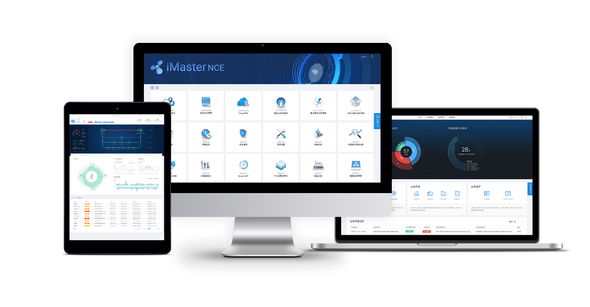

iMaster NCE Application
DC
iMaster NCE-Fabric *
Enterprise campus
iMaster NCE-Campus *
SD-WAN
iMaster NCE-WAN
IP WAN
iMaster NCE-IP
WAN transmission
iMaster NCE-T
* iMaster NCE-Fabric and iMaster NCE-Campus are introduced in this document.

Slide 25





Huawei CloudFabric DCN Autonomous Driving Network Solution
DC
Enterprise Campus
Based on iMaster NCE-Fabric, DCNs provide full-lifecycle services from planning, construction, O&M, to optimization.
Service Intent/Strategy
Integrated planning and construction:
The planning tool interconnects with iMaster NCE-Fabric to implement integrated planning and construction.
Zero Touch Provisioning (ZTP)
Simplification elements
Analyzer
Simplified deployment
Service intent self-understanding and conversion
Network change simulation and evaluation, eliminating human errors
+AI
Controller
Manager
Intelligent O&M:
Rapid fault detection and location based on knowledge graph and expert experience
Fast fault rectification based on expert experiences and simulation analysis
Telemetry & ERSPAN
NETCONF & SNMP
Real-time optimization:
AI-Fabric-oriented local traffic inference and online model training and optimization
User behavior prediction and resource optimization suggestions
VM
VM
VM
VM
VM
VM
VM
VM
VM

Slide 26
Simplified ZTP Deployment
DC
Enterprise Campus
Network administrator
ZTP deployment process:
The network administrator clicks the icon on iMaster NCE to start the ZTP task.
A device automatically obtains an IP address to access iMaster NCE.
iMaster NCE determines the device role (spine or leaf node), delivers configurations such as the management IP address, SNMP configuration, and NETCONF configuration to online devices, and manages the devices through the management IP address.
iMaster NCE globally delivers interconnection configurations as well as OSPF or BGP configurations.
The device goes online successfully, and the administrator views network-wide information on iMaster NCE.
1
5
2
3
4
Spine
VXLAN
Leaf
Note: The DC uses the spine-leaf architecture.

Slide 27
Network Intent Self-understanding and Fast Service Deployment
DC
Enterprise Campus
Network design
Configuration delivery
Service verification
2 to 3 days
10 minutes
1 to 2 days
iMaster NCE-Fabric
Verification result analysis
Intent conversion
Network design
Simulation verification
Network configuration
Work order
Built-in model:
ACL deployment
Network provisioning
Intent model
10 minutes
Huawei iMaster NCE-Fabric supports automatic and fast deployment of virtualization, cloud computing, and container networks.
Notes:
iMaster NCE-Fabric can connect to a user's IT system to match the intent model for user intents and deliver configurations to devices through NETCONF to implement fast service deployment.
iMaster NCE-Fabric can interconnect with the mainstream cloud platform (OpenStack), virtualization platform (vCenter/System Center), and container orchestration platforms (Kubernetes).

Slide 28
Network Change Simulation and Change Risk Prediction
DC
Enterprise Campus
Configuration to be changed
Resource sufficiency
Live network configuration
Access connectivity
Live network topology information
Network modeling
Formal verification algorithm
Impact on original services
Live network resource information
Data collection/upload
Modeling and Computing
Verification result
Establish physical, logical, and application network models.
Use the formal verification algorithm for computing.
Check whether resources on the live network are sufficient and whether the network is connected.
Analyze and display the impact of changes on original services.

Slide 29

AI-powered Intelligent O&M for DCNs
DC
Enterprise Campus
Collection
Analysis
Decision
Intelligent analysis engine
Knowledge inference engine
BGP
flapping
OSPF
flapping
Huawei's 30+ years of O&M
expert experience
Interface flapping
IS-IS
flapping
BFD
flapping
Manual rectification
Router ID conflict
Exception detection
Continuous learning and training
based on real site faults
Intent-based loop closing
Root cause analysis
Knowledge
Knowledge
Knowledge
Knowledge
Risk prediction
Recommended emergency plan:
Port isolation
Configuration rollback
Capacity expansion recommendation
Model application
DC holographic data
Service flow data/Telemetry data
Data cleaning
AI exception identification
Network object modeling
Notes:
iMaster NCE-FabricInsight provides AI-based intelligent O&M capabilities for DCs.

Slide 30



Huawei CloudCampus Autonomous Driving Network Solution
DC
Enterprise Campus
Fast network deployment, improving deployment efficiency by 600%
Analyzer
One-stop management platform
Device plug-and-play: simplified device deployment, scenario navigation, and template-based configuration
Simplified network deployment: Network resource pooling, multi-purpose network, and automatic service provisioning
Manager
Controller
Design
Deployment
Policy
Fast service provisioning, improving user experience by 100%
Free mobility: GUI-based policy configuration, allowing users to access the network anytime and anywhere without changing the roaming permission and user experience
Intelligent terminal identification: Anti-spoofing for terminal access, with an intelligent terminal identification accuracy of over 95%
Intelligent HQoS: Application-based scheduling and shaping, and refined bandwidth management, ensuring service experience of key users
NETCONF/YANG
Large- or medium-sized campus
Small- or medium-sized campus
Campus interconnection
VN for office purposes
WAN/
Internet
Fast intelligent O&M, improving network performance by over 50%
VN for R&D
Real-time experience visualization: Telemetry-based network experience visualization at each moment, for each user, and in each area
Precise fault analysis: Proactively identifying 85% of typical network issues and providing suggestions, and comparing and analyzing real-time data to predict faults
Intelligent network optimization: Predictive optimization of wireless networks based on historical data, improving network-wide performance by over 50% (Source: Tolly Certification)
VN for office services
Security group 1
Security group 2
Security group 3
Access control policy
Bandwidth
Priority
VN for R&D services
Security group 4
Security group 5

Slide 31





Device Plug-and-Play
DC
Enterprise Campus
Deployment by Scanning Bar Codes
DHCP-based Deployment
Deployment Through the Registration Query Center
1
1
1
2
Registration query center
4
3
4
3
5
4
DHCP server
3
2
2
Pre-configuration
Obtaining registration information through the DHCP server
Automatic device registration and login
Automatic configuration delivery
Pre-configuration
Information synchronization
Obtaining registration information through the registration query center
Automatic device registration and login
Automatic configuration delivery
Pre-configuration
Deployment by scanning bar codes
Automatic device registration and login
Automatic configuration delivery
Notes:
Device plug-and-play includes but is not limited to deployment by scanning bar codes using an app, DHCP-based deployment, and deployment through the registration query center.
Registration center: Huawei device registration query center, also called registration center, is one of the main components of Huawei CloudCampus solution. It is used to query the device management mode and registration ownership. A device determines whether to switch to the cloud-based management mode and which cloud management platform to register with based on the query result. The AP is used as an example. Huawei devices that support cloud-based management are pre-configured with the URL (register.naas.huawei.com) and port number (10020) of the Huawei device registration center.

Slide 32
Free Mobility: Policy Management Based on Security Groups
DC
Enterprise Campus
Free mobility: Enables users to have consistent network rights and security policies regardless of their locations and IP addresses.
Security group
for sales users
Security group
for R&D users
Security group
for server resources
Use security groups. A security group is a group of users for which the same security policy is used.
1
2
Define security group-based permission control policies and user experience policies and deliver the policies to network devices.
Right policy
Experience policy
Deliver security policies
3
A security group is authorized to a user after the user passes access authentication.
Campus
network
After user traffic enters a network, network devices enforce policies based on the source and destination security groups of the traffic.
4
Access authentication
Access authentication
Access authentication
User A
User B
User C

Slide 33



Wired and Wireless Convergence
DC
Enterprise Campus
WLAN Construction Mode 1: Standalone AC
WLAN Construction Mode 2: AC Card
This mode poses a wireless traffic bottleneck and increases faulty nodes.
Wired and wireless management is independent.
Wired and wireless authentication points are separated.
AC Card
Independent AC
An AC card is installed on a switch to provide AC functions.
Hardware-level convergence.
Wired and wireless authentication point separation, distributed policy control, separation of control and data traffic forwarding, and troubleshooting and management difficulties.
Wired and Wireless Convergence (Native AC)
The switch integrates the AC function, eliminating wireless traffic forwarding bottlenecks and reducing fault nodes. Wired and wireless devices are centrally managed.
Unified management and converged forwarding of wired and wireless services
Converged management for wired and wireless users and gateway convergence
Converged authentication points for wired and wireless access
Unified wired and wireless policy execution
Native AC

Slide 34


Intelligent Terminal Identification, Ensuring Secure Access
DC
Enterprise campus
Requirements and Challenges
Huawei supports identification of 1000+ office or IoT terminals.
A university
Built-in terminal fingerprint library
50+ types of smart terminals
Terminal information is collected by IT departments of colleges:
MAC address collection is difficult and error-prone.
>>
An enterprise
>>
100+ authentication faults reported per day
Terminal-type-based
Terminal-type-based
Terminal-type-based
It is difficult to locate access spoofing.
Automatic authentication
Printer
MAC address authentication, without entering any MAC address
Automatic authorization
Camera
Is automatically added to the video surveillance group.
Is configured as the VIP user.
Spoofing detection
IP phone and PC
Report a terminal spoofing alarm.

Slide 35
HQoS: User- and Application-based QoS Policy
DC
Enterprise campus
User- and application-based QoS policies ensure experience of high-priority users and applications
Requirements and Challenges
1
Traditional QoS policies are invalid for video services.
Define VIP users and common users, and application priorities.
Schedule users and application queues based on priorities of users and applications.
Support native AC or independent AC deployment.
3
(Example) Building surveillance scenario:
Wireless video services of common users increase, occupying a large number of network resources and causing network congestion.
>>
VIP
user 1
Common
users
2
...
...
VIP
users
Common
users
Camera
Video surveillance
Mobile phone and tablet

Slide 36


AI-Powered Intelligent O&M of Campus Networks
DC
Enterprise campus
As-Is: Device-Centered Network Management
To-Be: User Experience-Centered AI-Powered Intelligent O&M
Intelligent network analyzer
NMS
Visualized user experience management
User journey playback
Potential fault identification
Root cause identification
Predictive network optimization
Traditional NMS
Topology management
Performance management
Alarm management
Configuration management
Telemetry
Second-level network data collection
SNMP
Minute-level network data collection
Experience visualization: Telemetry-based second-level data collection, visualized experience of each user and each application in real time
Minute-level potential fault identification and root cause location
Identify potential faults based on dynamic baselines and big data correlation analysis.
Accurately locate root causes of faults through KPI association analysis and protocol tracing.
Predictive network optimization: AI is used to intelligently analyze the AP load trend and implement predictive optimization on the wireless network.
Device-centric O&M method: User experience cannot be detected.
Fault-triggered responses: Potential faults cannot be identified.
Rely on professional engineers to locate faults onsite.
The efficiency is improved by using algorithms. With scenario-based continuous learning and expert experience, intelligent O&M frees O&M personnel from complex alarms and noises, making O&M more automated and intelligent.

Slide 37


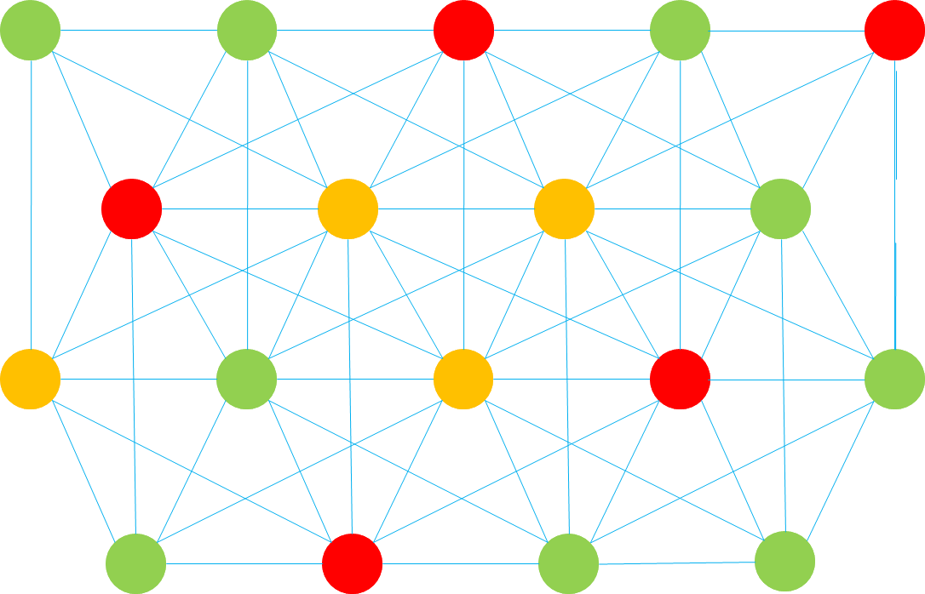
AI-Powered Intelligent Radio Calibration
DC
Enterprise campus
Traditional radio calibration cannot achieve
expected results
Tested and verified by authoritative organizations
AI-powered intelligent radio calibration
Phase 1: Manual Calibration
Based on engineers' experience, the calibration is time-consuming and error-prone, and the calibration result is unstable.
Average downlink rate per terminal:
58%
198 Mbit/s
125 Mbit/s
Radio calibration simulation
Real-time and historical data collection
>>
Before radio calibration
After AI-powered smart radio calibration
Smart radio calibration and closed-loop
Calibration
Counter
Phase 2: Automatic Calibration
Calibration based on real-time radio interference does not consider device load changes, and the calibration result cannot be ensured.
Average Wi-Fi channel interference
5.5%
49%
Single-user performance
Optimal channel selection
Frequency bandwidth selection
Power adjustment
Number of users
2.8%
Objects
Channel usage
Time
Signal interference ratio
Before radio calibration
After AI-powered smart radio calibration
Channel/Frequency bandwidth/Power

Slide 38
SDN Overview
NFV Overview

Slide 39
NFV Background: Thinking from IT Industry Transformation
The IT industry transformation brings thinking on network architecture and device architecture in the network industry. The network architecture layer involves the SDN controller and the device architecture layer involves the device deployment mode.
IT Industry Transformation
Network?
In recent years, IT technologies such as virtualization and cloud computing have been booming, and applications deployed on hardware have been gradually migrated to the cloud. Applications are deployed on private clouds, public clouds, or hybrid clouds as software.
Thinking about the network industry: Can network applications be deployed in a software-based manner?
In the context, Network Functions Virtualization (NFV) is introduced.
App
App
App
OS
OS
Virtualization/Cloudification
VM
VM
OS
Notes:
Virtualized network functions (VNFs) are implemented by virtualizing traditional NEs such as IMSs and CPEs of carriers. After hardware is universalized, traditional NEs are no longer the products with embedded software and hardware. Instead, they are installed on universal hardware (NFVI) as software.

Slide 40

Origin of NFV
In October 2012, 13 top carriers (including AT&T, Verizon, VDF, DT, T-Mobile, BT, and Telefonica) released the first version of NFV White Paper at the SDN and OpenFlow World Congress. In addition, the Industry Specification Group (ISG) was founded to promote the definition of network virtualization requirements and the formulation of the system architecture.
In 2013, the ETSI NFV ISG conducted the first phase of research and completed the formulation of related standards. The ETSI NFV ISG defined NFV requirements and architecture and sorts out the standardization processes of different interfaces.
Notes:
In 2015, NFV research entered the second phase. The main research objective is to build an interoperable NFV ecosystem, promote wider industry participation, and ensure that the requirements defined in phase 1 are met. In addition, the ETSI NFV ISG specified the collaboration relationships between NFV and SDN standards and open source projects. Five working groups are involved in NFV phase 2: IFA (architecture and interface), EVE (ecosystem), REL (reliability), SEC (security), and TST (test, execution, and open source). Each working group mainly discusses the deliverable document framework and delivery plan.
The ETSI NFV standard organization cooperates with the Linux Foundation to start the open source project OPNFV (NFV open source project, providing an integrated and open reference platform), integrate resources in the industry, and actively build the NFV industry ecosystem. In 2015, OPNFV released the first version, further promoting NFV commercial deployment.
NFV-related standard organizations include:
ETSI NFV ISG: formulates NFV requirements and functional frameworks.
3GPP SA5 working group: focuses on technical standards and specifications of 3GPP NE virtualization management (MANO-related).
OPNFV: provides an open-source platform project that accelerates NFV marketization.

Slide 41
NFV Value
NFV aims to address issues such as complex deployment and O&M and service innovation difficulties due to large numbers of telecom network hardware devices. NFV brings the following benefits to carriers while reconstructing telecom networks:
Shortened service rollout time
Reduced network construction cost
Improved network O&M efficiency
Open ecosystem
Notes:
Shortened service rollout time: In the NFV architecture, adding new service nodes becomes simple. No complex site survey or hardware installation is required. For service deployment, you only need to request virtual resources (compute, storage, and network resources) and software loading, simplifying network deployment. To update service logic, you simply need to add new software or load new service modules to complete service orchestration. Service innovations become simple.
Reduced network construction cost: Virtualized NEs can be integrated into COTS devices to reduce the cost. Enhancing network resource utilization and lowering power consumption can lower overall network costs. NFV uses cloud computing technologies and universal hardware to build a unified resource pool. Resources are dynamically allocated on demand based on service requirements, implementing resource sharing and improving resource utilization. For example, automatic scale-in and scale-out can be used to solve the resource usage problem in the tidal effect.
Enhanced network O&M efficiency: Automated and centralized management improves the operation efficiency and reduces the O&M cost. Automation includes DC-based hardware unit management automation, MANO application service life management automation, NFV- or SDN-based coordinated network automation.
Open ecosystem: The legacy telecom network exclusive software/hardware model defines a closed system. NFV-based telecom networks use an architecture based on standard hardware platforms and virtual software. The architecture easily provides open platforms and open interfaces for third-party developers, and allows carriers to build open ecosystems together with third-party partners.

Slide 42
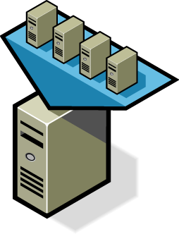
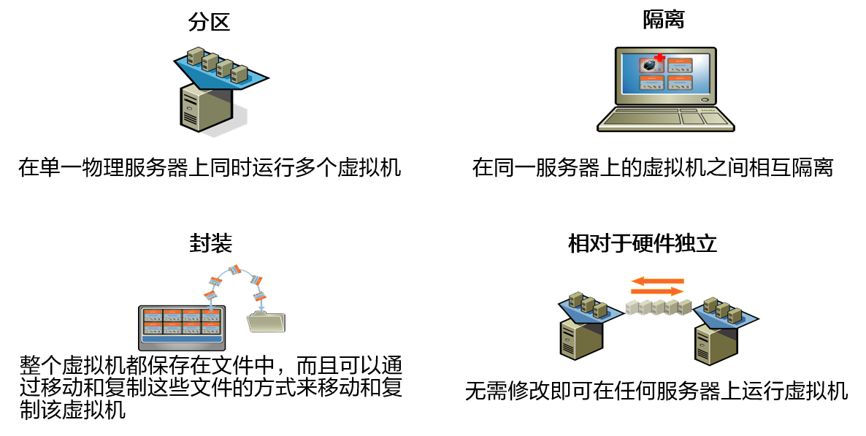
Key NFV Technologies: Virtualization
Virtualization is the foundation of NFV, and cloudification is the key.
On traditional telecom networks, each NE is implemented by dedicated hardware, resulting in high costs and difficult O&M. Virtualization features partition, isolation, encapsulation, and independence from hardware, which can meet NFV requirements. Carriers use virtualization to run software-based NEs on universal infrastructures.
Partition
Isolation
Multiple VMs can concurrently run on a single physical server.
VMs that run on the same server are isolated from each other.
Encapsulation
Hardware independence
All data of a VM is saved in files. A VM can be moved and replicated by moving and replicating the files.
VMs can run on any servers without any modifications.
Notes:
On traditional telecom networks, each NE is implemented by dedicated hardware. A large number of hardware interoperability tests, installation, and configuration are required during network construction, which is time-consuming and labor-consuming. In addition, service innovation depends on the implementation of hardware vendors, which is time-consuming and cannot meet carriers' service innovation requirements. In this context, carriers want to introduce the virtualization mode to provide software NEs and run them on universal infrastructures (including universal servers, storage devices, and switches).
Using universal hardware helps carriers reduce the cost of purchasing dedicated hardware. Service software can be rapidly developed through iteration, which enables carriers to innovate services quickly and improve their competitiveness. By dong this, carriers can enter the cloud computing market.

Slide 43
Key NFV Technology: Cloudification
As defined by the National Institute of Standards and Technology (NIST), cloud computing is a model that allows users to obtain resources (for example, networks, servers, storage devices, applications, services) in a shared compute resource pool based on their needs anytime, anywhere. This model enables fast resource provisioning and release, and minimizes the resource management workload and interactions with service providers.
Cloud computing has many advantages. Cloudification of network functions on carriers' networks mainly uses resource pooling and rapid elastic scaling.
Characteristics of Cloud Computing
1
On-demand self-service
2
Broad network access
3
Resource pooling
4
Rapid elasticity
5
Measured service
B
u
y
Notes:
According to the NIST, cloud computing services have the following characteristics:
On-demand self-service: Cloud computing implements on-demand self-service of IT resources. Resources cna be requested and released without intervention of IT administrators.
Broad network access: Users can access networks anytime and anywhere.
Resource pooling: Resources including networks, servers, and storage devices in a resource pool can be provided for users.
Rapid elasticity: Resources can be quickly provisioned and released. The resource can be used immediately after being requested, and can be reclaimed immediately after being released.
Measured service: The charging basis is that used resources are measurable. For example, charging is based on the number of CPUs, storage space, and network bandwidth.

Slide 44
Introduction to the NFV Architecture
The NFV architecture includes the network functions virtualization infrastructure (NFVI), a virtualized network function (VNF), and management and orchestration (MANO). In addition, the NFV architecture needs to support the existing business support system (BSS) or operations support system (OSS).
OSS/BSS: is an existing operation/O&M support system.
VNF: uses cloud resources to construct software NEs.
MANO:
Provides functions such as service orchestration, service management, and resource management.
NFVI: provides cloud-based resource pools.
Notes:
Each layer of the NFV architecture can be provided by different vendors, which improves system development but increases system integration complexity.
NFV implements efficient resource utilization through device normalization and software and hardware decoupling, reducing carriers' TCO, shortening service rollout time, and building an open industry ecosystem.
The NFVI consists of the hardware layer and virtualization layer, which are also called COTS and CloudOS in the industry.
COTS: universal hardware, focusing on availability and universality, for example, Huawei FusionServer series hardware server.
CloudOS: cloud-based platform software, which can be regarded as the operating system of the telecom industry. CloudOS virtualizes physical compute, storage, and network resources into virtual resources for upper-layer software to use, for example, Huawei FusionSphere.
VNF: A VNF can be considered as an app with different network functions and is implemented by software of traditional NEs (such as IMS, EPC, BRAS, and CPE) of carriers.
MANO: MANO is introduced to provision network services in the NFV multi-CT or multi-IT vendor environment, including allocating physical and virtual resources, vertically streamlining management layers, and quickly adapting to and interconnecting with new vendors' NEs. The MANO includes the Network Functions Virtualization Orchestrator (NFVO, responsible for lifecycle management of network services), Virtualized Network Function Manager (VNFM, responsible for lifecycle management of VNFs), and Virtualized Infrastructure Manager (VIM, responsible for resource management of the NFVI).

Slide 45
Standard NFV Architecture
ETSI defines the standard NFV architecture, which consists of the NFVI, VNF, and MANO. The NFVI includes the universal hardware layer and virtualization layer. The VNF is implemented using software, and the MANO implements management and orchestration of an NFV architecture.
NFV Management and Orchestration
MANO
Os-Ma
OSS/BSS
NFV
Orchestrator
VNF
Or-Vnfm
EM 1
EM 2
EM 3
Ve-Vnfm
Service, VNF, and
VNF
Infrastructure
VNF 1
VNF 2
VNF 3
Manager(s)
Description
Vn-Nf
NFVI
Vi-Vnfm
Virtualization Layer
Virtual
Virtual
Virtual
Nf-Vi
Virtualized
Or-Vi
Computing
Storage
Network
Infrastructure
Vi-Ha
Manager(s)
Hardware
Computing
Storage
Network
Execution reference point
Other reference point
Main NFV reference points

Slide 46
Functional Modules of the NFV Architecture
Main functional modules defined in the standard NFV architecture:
OSS or BSS
Management system for a service provider. It is not a functional component in the NFV architecture, but the MANO must provide an interface for interoperation with the OSS or BSS.
MANO
NFV management and orchestration. The MANO includes the VIM, VNFM, and NFVO, and provides unified management and orchestration for VNFs and the NFVI.
VIM: NFVI management module that runs on an infrastructure site. The VIM provides functions such as resource discovery, virtual resource management and allocation, and fault handling.
VNFM: It controls the VNF lifecycle (including instantiation, configuration, and shutdown).
NFVO: It orchestrates and manages all the software resources and network services on an NFV network.
VNF
VNFs refer to VMs as well as service NEs and network function software deployed on the VMs.
NFVI
NFV infrastructure, including required hardware and software. The NFVI provides a running environment for VNFs.
Hardware layer: includes hardware devices that provide compute, network, and storage resources.
Virtualization layer: abstracts hardware resources to form virtual resources, such as virtual compute, storage, and network resources. The virtualization function is implemented by Hypervisor^{[1]}.
Notes:
BSS: business support system
OSS: operation support system
A hypervisor is a software layer between physical servers and OSs. It allows multiple OSs and applications to share the same set of physical hardware. It can be regarded as a meta operating system in the virtual environment, and can coordinate all physical resources and VMs on the server. It is also called virtual machine monitor (VMM). The hypervisor is the core of all virtualization technologies. Mainstream hypervisors include KVM, VMWare ESXi, Xen, and Hyper-V.

Slide 47
NFV Architecture Interfaces
Main interfaces of the standard NFV architecture:
Interface | Description
Vi-Ha | Is used between the virtualization layer and hardware layer. The virtualization layer meets basic hardware compatibility requirements.
Vn-Nf | Is used between a VM and the NFVI. It ensures that VMs can be deployed on the NFVI to meet performance, reliability, and scalability requirements. The NFVI meets VMs' OS compatibility requirements.
Nf-Vi | Is used between the virtualization layer management software and NFVI. It provides management of virtual computing, storage, and network systems of NFVI, virtual infrastructure configuration and connections, as well as system usage, performance monitoring, and fault management.
Ve-Vnfm | Is used between the VNFM and a VNF, implementing VNF lifecycle management, VNF configuration, VNF performance, and fault management.
OS-Ma | Manages lifecycles of network services and VNFs.
Vi-Vnfm | Is used for interaction between the service application management system or service orchestration system and virtualization layer management software.
Or-Vnfm | Sends configuration information to the VNFM, configures the VNFM, and connects the orchestrator and VNFM. It exchanges information with the NFVI resources allocated to VNFs and information between VNFs.
Or-Vi | Is used to send resource reservation and resource allocation requests required by the orchestrator and exchange virtual hardware resource configurations and status information.

Slide 48
Huawei's NFV Solution
In the Huawei NFV architecture, functions of the virtualization layer and VIM are implemented by the HUAWEI CLOUD Stack NFVI platform. HUAWEI CLOUD Stack can virtualize compute, storage, and network resources and centrally manage, monitor, and optimize physical virtualization resources.
Huawei provides cloud-based solutions for carriers' wireless networks, bearer networks, transport networks, access networks, and core networks.
VNF
MANO
Cloud
DSL/OLT
CloudOpera
CloudBB
CloudEdge
CloudCore
5G Core
NFVO
VNFM
NFVI
HUAWEI CLOUD Stack
FusionSphere OpenStack + OM
FusionCompute
FusionStorage
FusionNetwork
Hardware
Computing Storage Network
Notes:
DSL: Digital Subscriber Line
OLT: Optical Line Terminal

Slide 49
FAQ
Q1: What is the relationship between SDN and NFV in the industry?
A: Both SDN and NFV involve network transformation and the NFV concept was proposed at the SDN and OpenFlow World Congress. However, they are independent of each other. SDN mainly affects the network architecture, and NFV mainly affects the NE deployment mode.
Q2: What is the relationship between SDN and NFV in Huawei solutions?
A: Huawei provides different solutions for SDN and NFV, but they are associated. Huawei NFVI solution is provided by HUAWEI CLOUD Stack.

Slide 50
(Multiple) Which of the following statements about Huawei SDN solution are true? ( )
The solution supports various SBI protocols, such as RESTful, NETCONF, and OVSDB.
OpenFlow can be used as the SBI protocol.
The solution integrates management, control, and analysis to build a simplified network.
The solution provides open and programmable network interfaces to support third-party application development and system interconnection.
Please briefly describe the benefits of NFV.
Notes:
BCD
NFV aims to address issues such as complex deployment and O&M and service innovation difficulties due to large numbers of telecom network hardware devices. NFV brings the following benefits to carriers while reconstructing telecom networks:
Shortened service rollout time
Reduced network construction cost
Improved network O&M efficiency
Open ecosystem

Slide 51
With the transformation and development of the network industry, SDN and NFV are proposed.
SDN is an innovation of network architecture. It uses a controller to make networks more open, flexible, and simple.
NFV is an innovation in the deployment of telecom network devices. Based on virtualization and cloud computing, NFV helps reconstruct telecom networks.

Slide 52
For more information about OpenFlow, visit https://www.opennetworking.org/ .
For more information about Huawei SDN solution, see the HCIP course.

